Slide 1
A Netlogo's model for distributed BPM synchronization
UNIVERSITY OF MODENA AND REGGIO EMILIA
"Enzo Ferrari" Engineering Department
Master's Degree in Computer Engineering
_________________________________________________________________________________________________
Student: Fabio Romagnolo.
Academic Year 2021/2022

Slide 2


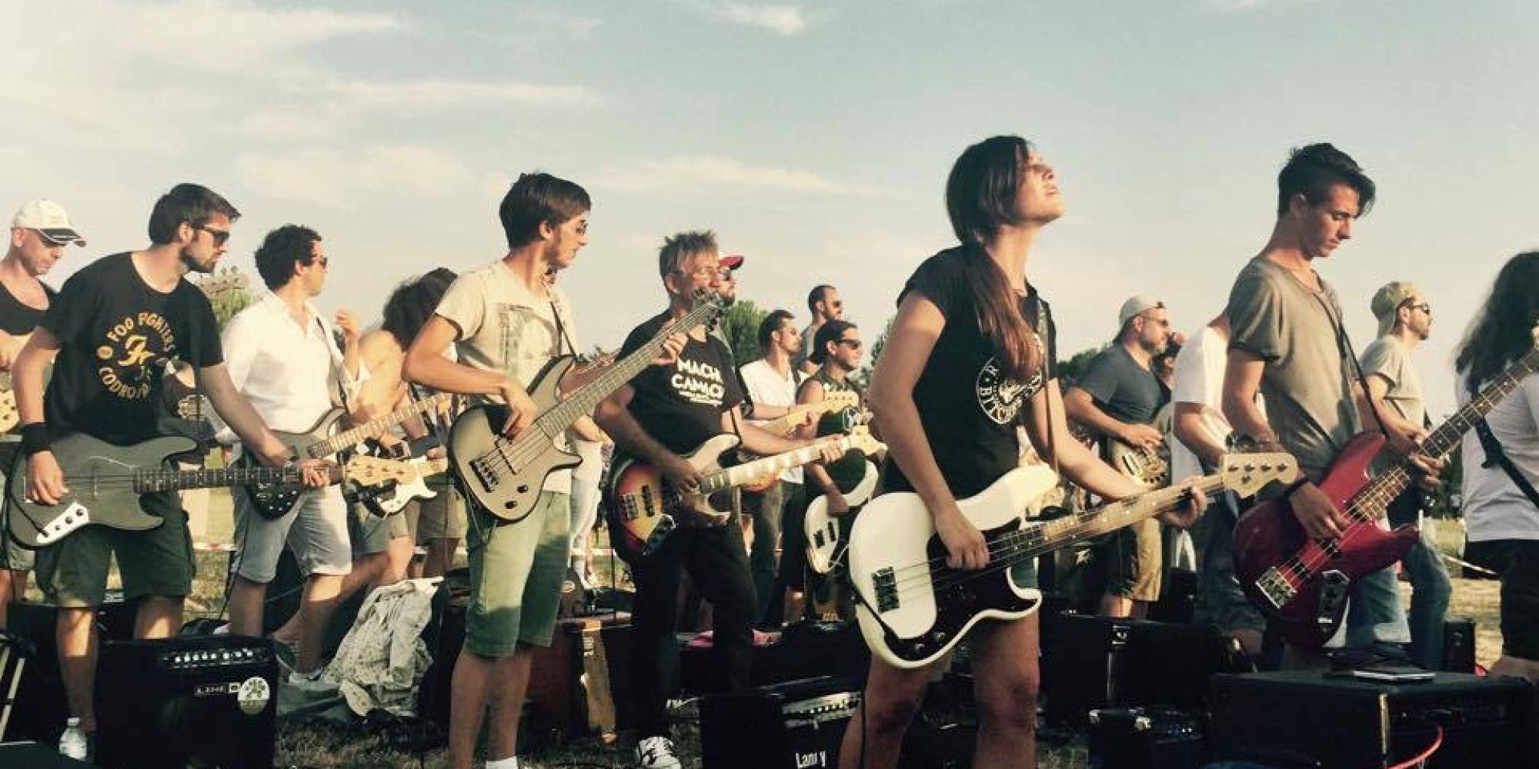
Introduction
NetLogo is a multi-agent programmable modeling environment. It has been used to develop the following original model and to make experiments on it with different parameters.
The model demonstrates a group of musicians synchronizing their perception of time in terms of BPM (beats-per-minute). Musicians play but also listen to what the others are playing and try to adapt their speed of playing to what they perceive. It is a good example of how a distributed system can coordinate itself without any central coordinator.
The idea came up from events like the ones organized by Rockin’1000, where a huge number of musicians play together thanks to a centralized metronome: in this way, they perceive the same BPM from the beginning.
But what if they had no metronome? Would they still be able to coordinate and play at same speed? This model tries to answer the question.

Slide 3
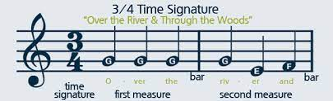
Introduction
Before presenting the model let's introduce some musical basic concepts.
Beat: a beat is defined as a regular pulse that underlies a musical pattern. It's the basic measurement of time. When listening to music, people tap their foot in time with the beat and musicians count this measurement when performing their tracks.
BPM: also defined as tempo, it is the unit of measure for beats. For instance, 120 BPM are measured as having 120 beats within a minute. It is basically the speed of that music is played at.
Bar: a bar is one small segment of music that holds some beats. Basically, multiple beats make up a bar and multiple bars make up a song. The number of beats in a bar is wholly dependent on the time signature of the specific song. The most popular time signature of all time is 4/4. The first number indicates the number of beats to count per bar (four in this case), and the second number tells you what kind of note you need to be counting (a quarter note in this case).

Slide 4
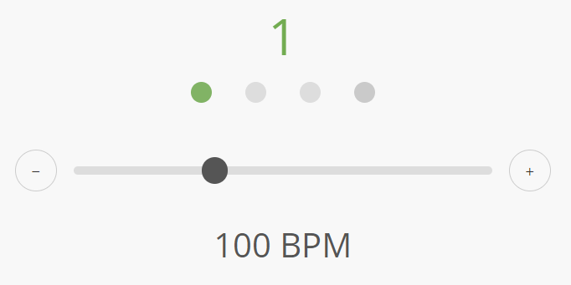
Netlogo's model
Each musician follows its own musical sheet. For simplicity, the sheet is in this case one single note played during only one of the beats in the bar. To make everybody playing different patterns, the beat on which they play is randomly chosen at the beginning of simulation.
Even if the note is equal for everybody (middle C), the instruments are instead chosen randomly in the setup procedure. This allows music to be etherogeneus, but also armonic.
A metronome increases its own beat counter every 60.0 / BPM seconds and so the musicians mentally do when they’re playing in real contexts. A musician needs at least half second to estimate the BPM he’s perceiving: if these are perceived smaller w.r.t. his own then he decelerates, otherwise he accelerates, in any case by 1 BPM.
This is exactly what happens when two or more people play, sing, dance or clap hands together without agreeing before on same timing. Musicians are intelligent enough to adapt perfectly their speed when this difference perceived is small: in the model this gap is considered equal to 1.

Slide 5
Netlogo's model
At the start of the simulation all musicians begin playing following random BPM between 80 and 120: a difference greater then 40 BPM is quite impossible to find in the real world because it’s too easy to recognize.
The following parameters can be set by Netlogo's user interface:
Dimension: sets the dimension of the simulation. D * D musicians will spawn in a squared formation.
Radius: sets the radius of listening for each musician. For instance, if the radius is equal to 1, the musician will listen to maximum 4 neighbours.
Beats-per-bar: sets the beats-per-bar, known to everyone at the beginning of simulation. It affects only how many musicians are playing on different beats, so it changes the rithym of music.
Listen-delay-seconds: sets the seconds of listen delay for each musician. It makes the convergence faster or slower w.r.t. to the musician’s ability to listen efficiently the others while playing. If this parameter is equal to 0, they will be able to synchronize istantly like robots, but this is certainly unreal: the normal values should be equal to 0.5 or 1.

Slide 6
Netlogo's model
Confuse musicians!: this button triggers the procedure to confuse musicians making them accelerating or decelerating randomly by a BPM value which ranges from 2 to 30.
N-of-confused-musicians: sets the number of musicians to be confused. The higher is, the more perturbation we will have in the system.
Bpm-mean-approximation: sets the method of approximation for the estimation of mean bpm around each musician. It can be “floor” (floor value of BPM mean perceived in neighborhood is taken) or “ceiling”. This will ensure global BPM mean decreasing during the simulation in the first case, increasing instead in the latter.
Enable-audio?: if switch set to on, the audio of simulation will be turned on.
Show-mute-musicians?: if switch set to on, mute musicians are displayed in gray. In the opposite case they are invisible until they play again.

Slide 7
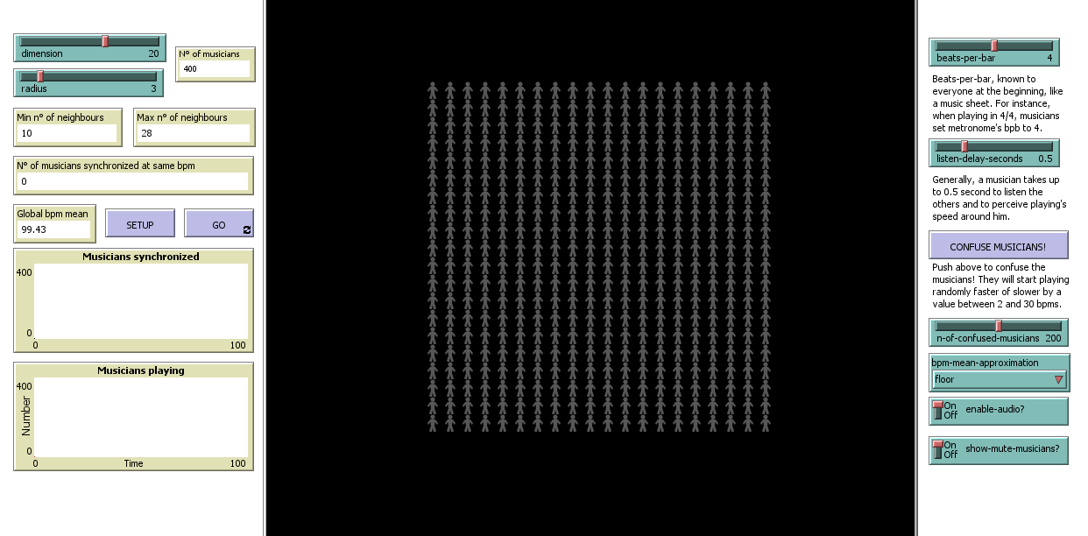

Slide 8


Slide 9
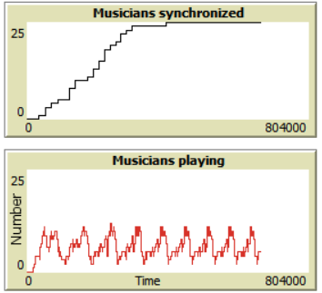
System's dynamics
Independently from initial conditions, the system will converge always to an overall periodic behavior. As the simulation proceeds it's possible to listen how slowly the music will have no more random timing.
The musical agents are adaptive to perturbations. Even if they are confused, they still will certainly succeed playing the right rhythm thanks to the other musicians, finding together a new agreement on the global BPM value.
In order to understand how actually the system reaches the convergence, several experiments have been done with different parameter values.

Slide 10
System's dynamics
Because of the random BPM initialization between 80 and 120, the experimental data have been computed as mean of 5 consecutive simulations for each configuration. Anyway, results showed that the Netlogo's functions used are purely pseudo-random, letting data being enough reliable even from just one run.
Before showing the results of analysis, the following known assumptions must be considered:
Cases where listen-delay-seconds is equal to 0 are not considered. They are simply impossible to find in musical contexts: in fact, BPM synchronization would occur instantly.
Beats-per-bar parameter does not affect the system's dynamics: it simply alters how many musicians are playing on different beats, changing the overall rhythm of music.
Bpm-mean-approximation parameter affects only the positivity or negativity of global mean BPM gap from beginning of simulation to the convergence moment.

Slide 11
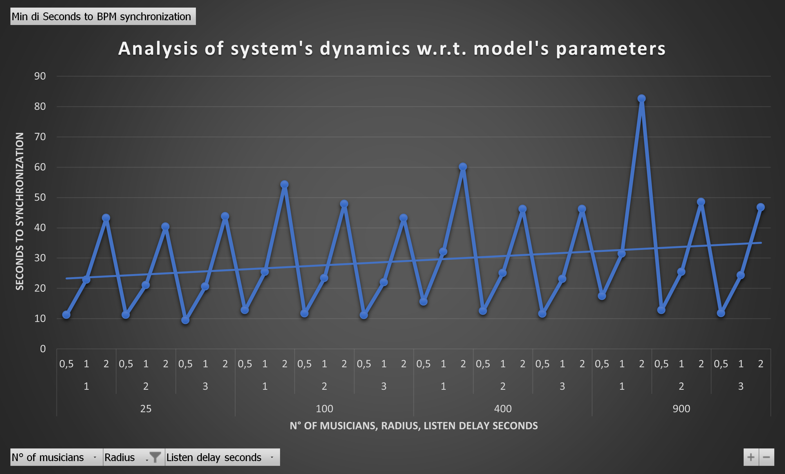
System's dynamics
The following graph synthetizes the pivot table constructed from simulation's data: we can draw out some conclusions on it:
Radius parameter begins to affect the system's dynamics only when the number of musicians becomes important. As this grows up, the radius equal to 1 is no more enough to guarantee a small time of convergence, especially when also the listen delay is high, as we can see from the peak.
We can interpret short listen delay seconds as the ability of musicians to adapt efficiently. In fact, as they double up, we can see that also the seconds to synchronization at least double up.

Slide 12
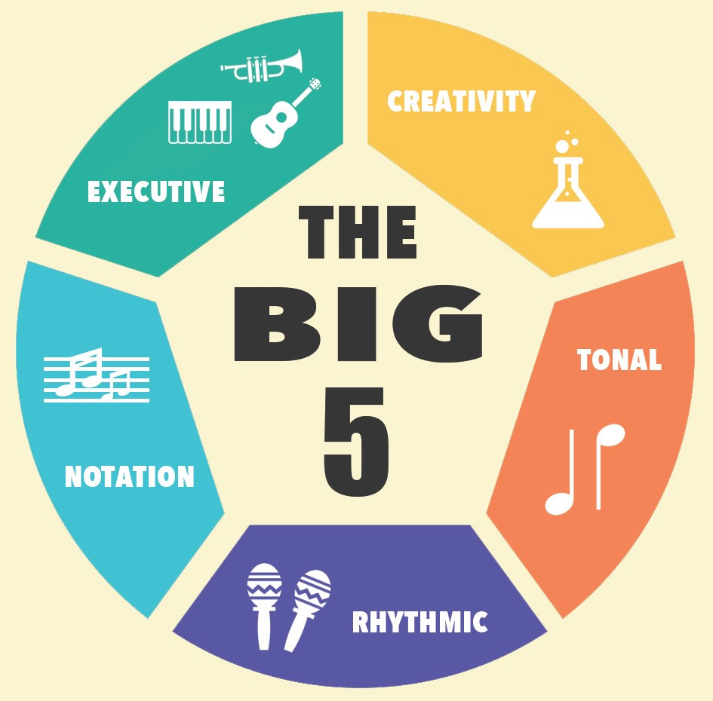
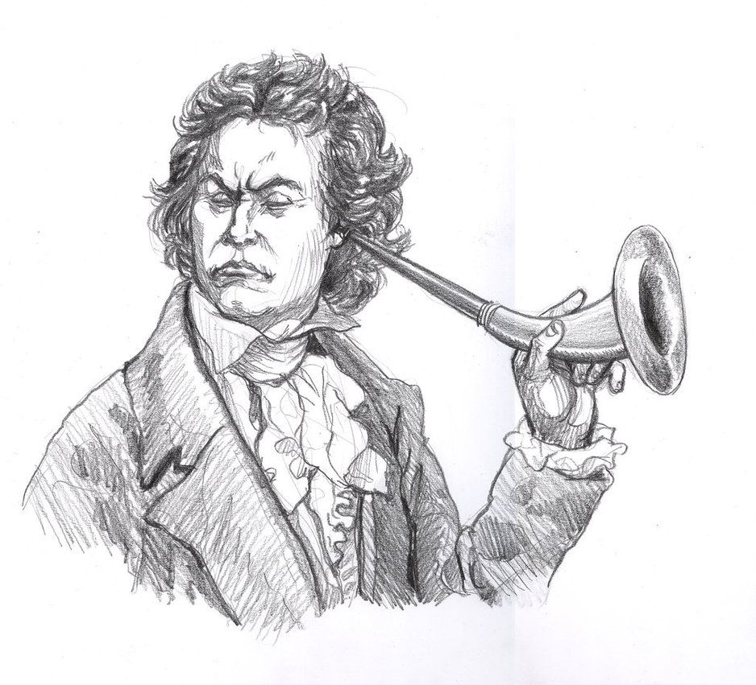

Conclusions
The developed model shows for sure an adaptive distributed system to random perturbations, but still there are strong assumptions like equal abilities among musicians in terms of listen delay. Anyway, the model has been written in order to be easily extensible, so we can think about to implement also these possible scenarios:
Assigning to each musician different listen delays to differentiate skills.
Introducing deaf musicians to see how much this impact the overall timing.
Providing classes of musicians playing same musical sheets, as normally happens in an orchestra. Would they still be able to synchronize their BPM in a distributed way?

Slide 13
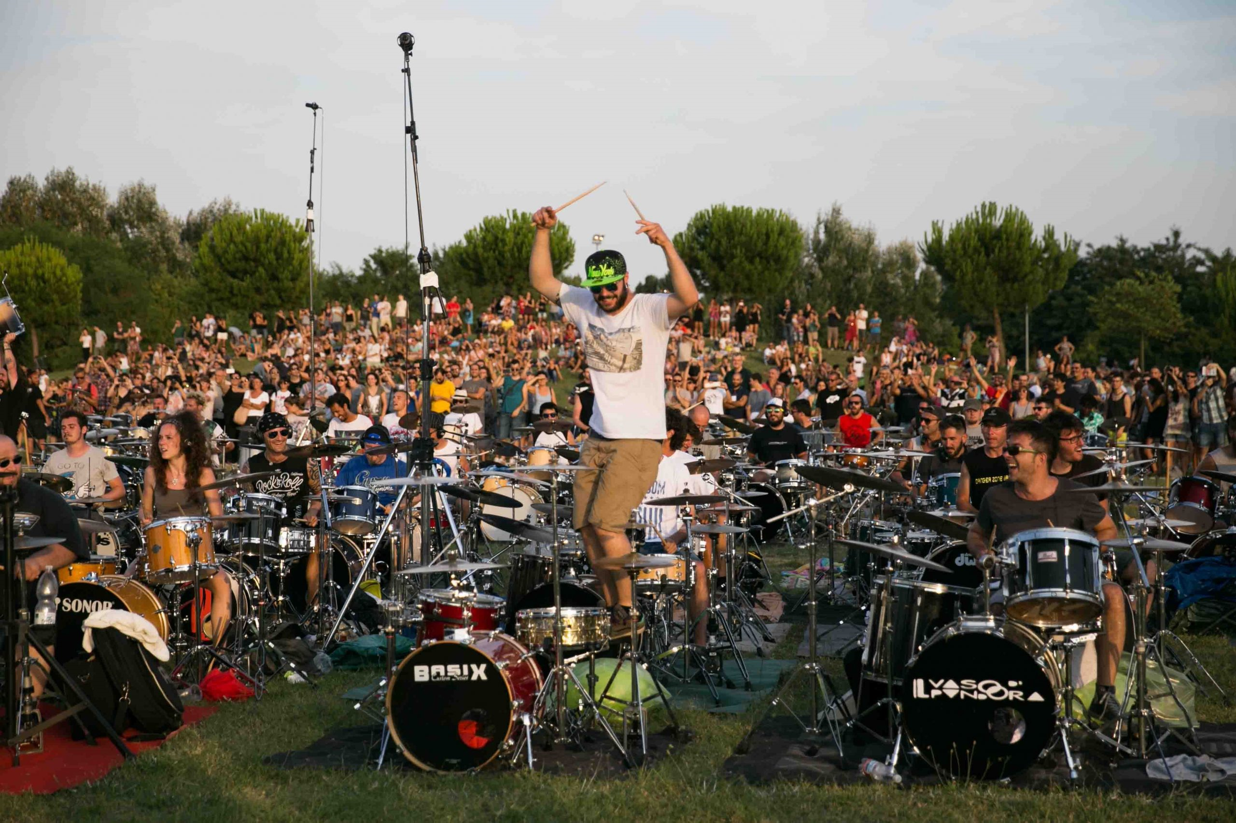
Thanks for your attention!

